Slide 1
Week 10 Notes
PHY495: Hoop Never Misses

Slide 2
What I’ve Done
Ball wasn’t registering as hitting the backboard so spent a while fixing this (there was also a tangent issue where it was returning values from –pi/2 to pi/2 but we want angles 0 to pi)

Slide 3
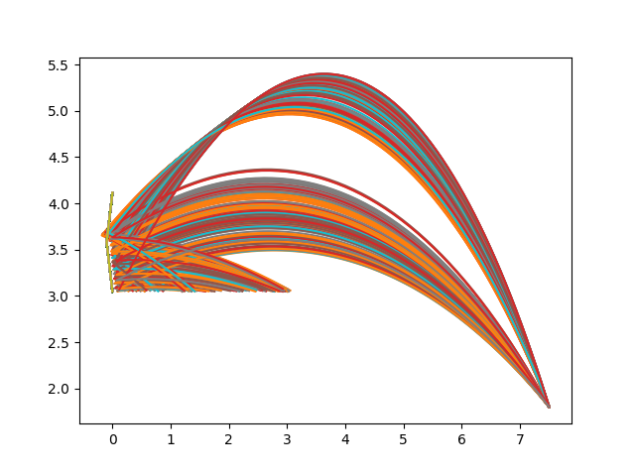
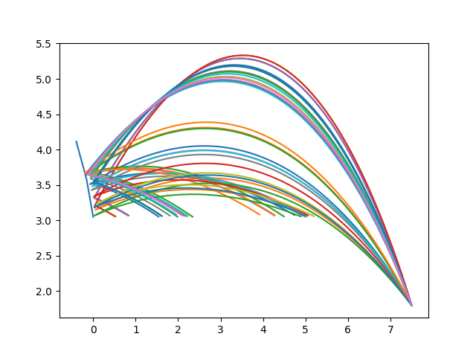
What Worked
Got the trajectories working with different backboards
Chose backboard values
Random backboard

Slide 4
Where am I Stuck
Keep getting problems pushing/pulling

Slide 5
What Next?
Compare different three point backboards to see which corresponds to a higher percentage of shots in
Extend to backboards of more than three points

